Slide 1

Introduction into jQuery
Prepared by Nazar Yuras

Slide 2
jQuery Basic Syntax
$(selector).action()
Приклади:
$("p").hide()
$(".test").hide()
$("#test").hide()

Slide 3
jQuery Effects
hide() / show()
toggle()
fadeIn() / fadeOut() / fadeToggle() / fadeTo()
animate({params})

Slide 4
Showing and hiding content
jQuery can show or hide content instantaneously with .show() or .hide().
// Instantaneously hide all paragraphs
$( 'p' ).hide();
// Instantaneously show all divs that have the hidden style class
$( 'div.hidden' ).show();

Slide 5
Animated hiding and showing
// Slowly hide all paragraphs
$('p').hide('slow');
// Show all divs that have the hidden style class over 0.5 sec
$('div.hidden').show(500);

Slide 6
Fade and Slide animations
// Hide all paragraphs using a slide up animation over 0.8 seconds
$('p').slideUp(800);
// Show all hidden divs using a slide down animation over 0.6 seconds
$('div.hidden').slideDown(600);
// Hide all paragraphs using a fade out animation over 1.5 seconds
$('p').fadeOut(1500);
// Show all hidden divs using a fade in animation over 0.75 seconds
$('div.hidden').fadeIn(750);

Slide 7
Changing Display Based on Current Visibility State
// Instantaneously toggle the display of all paragraphs
$('p').toggle();
// Slowly toggle the display of all images
$('img').toggle('slow');
// Toggle the display of all ordered lists over 1 second using slide up/down
$('ol').slideToggle(1000);
// Toggle the display of all blockquotes over 0.4 seconds using fade in/out
$('blockquote').fadeToggle(400);

Slide 8

jQuery DOM Manipulation

Slide 9
jQuery Ready Event
• Example:
$(document).ready(function(){
alert('welcome');
});
• Alternative form:
$(function() {
alert('welcome');
});

Slide 10
Reading and Changing HTML Contents
Get content:
.html()
.text()
.val()
Sample: var htmlString = $('#mydiv').html();
Коли метод використовується як сеттер, то він задає HTML-вміст всіх елементів в наборі.
Sample: $('div').html('<p>Hello!</p>');

Slide 11
Reading and changing class info
jQuery дозволяє читати, додавати, чи видаляти інформацію про клас для довільного елементу.
.addClass() – adds class: $('p').addClass('myClass');
.removeClass() – removes class: $('p').removeClass('myClass');
.hasClass() – checks if class is assigned: $('#myp').hasClass('myClass');
.toggleClass() – adds class if it is not assigned and vice versa: $('#myp').toggleClass('myClass');
$('p').removeClass('myClass noClass').addClass('yourClass');

Slide 12

jQuery Event Basics

Slide 13
Setting up Browser onclick Event
Next example setups onclick event handler for all paragraphs on a page:
// Event setup using a convenience method
$( 'p' ).click(function() {
console.log( 'You clicked a paragraph!' );
});

Slide 14
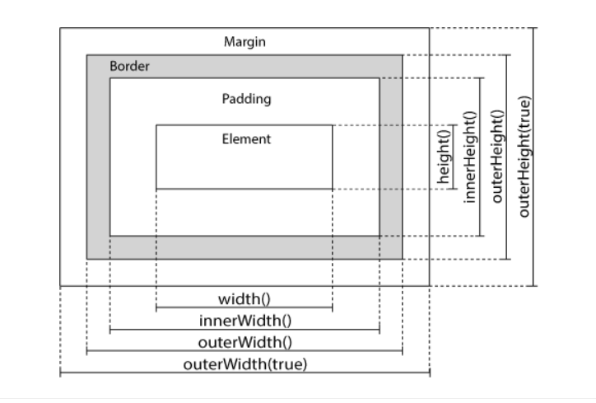
jQuery Dimensions

Slide 15
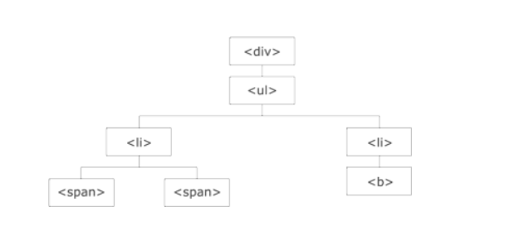
jQuery Traversing

Slide 16
jQuery Traversing - Ancestors
Three useful methods for traversing up the DOM tree are:
parent()
parents()
parentsUntil()

Slide 17
jQuery Traversing - Descendants
Two useful jQuery methods for traversing down the DOM tree are:
children()
find()

Slide 18
jQuery Traversing - Filtering
The most basic filtering methods are:
first()
last()
eq()
Other filtering methods, like filter() and not() allow you to select elements that match, or do not match, a certain criteria.

Slide 19
THANKS FOR ATTENTION!
хочу 50))

